Slide 1
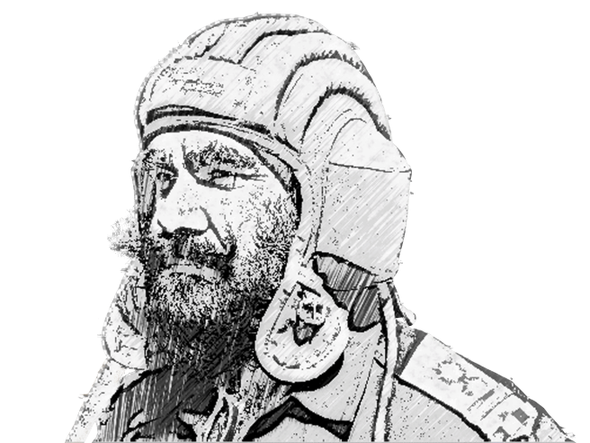

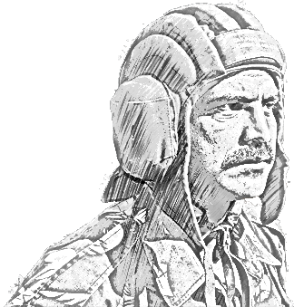
SCHOOL OF TECH TRG
ALWAYS CONNECTED
ELECTRONICS WING

Slide 2

INTRODUCTION

Slide 3
AIM
Class ko AH RT guidance ke bare mai jaankari hasil karana.

Slide 4
SCOPE
PART I : AH Gen Data
PART II : AH RT Proc ki Zarurat
PART III : Abvns
PART IV : Checklist
PART V : AH RT Proc

Slide 5
PART I : AH Gen Data

Slide 6
AH GEN DATA : MI- 35
WT – 12 TON
MAX SPEED - 335 Kmph
TOTAL FUEL - 2055 Ltr
ARMT CAPB
ANTI TK MSL – SH TURM
RG - 1000 TO 5000 Mtr
SPEED - SUPER SONIC
ARMR PENETRATION UPTO 560 MM
NOSE GUN
CALIBER - 12.7 MM
RG - 1600 Mtr
ROF - 4000- 5000 RDS PER MIN
ROCKETS
57 MM - RG 2 KM
80 MM - RG 2 KM
240 MM - HARD TGT (A VEHs)

Slide 7
AH GEN DATA : MI- 35
BOMB VARIANTS- 100 KG, 250 KG AND 500 KG
23 MM GSH AUTOMATIC GUN
TWIN BRL
ROF – 3000 TO 3400 RDS PER MIN
RADIO SET – R 828(20 TO 50 MHz)

Slide 8
PART II : AH RT Proc ki Zarurat

Slide 9
AH RT PROC KI ZARURAT
Firepower, Tgt- Soft and Hard
Mech elements ke sath
Ops of War:
Adv
Attk
Def

Slide 10
PART III : Abvns

Slide 11
BASIC ABVNS
SER NO | ABVN | FULL FORM
1. | JOC | JT OP CENTRE
2. | GLO | GRND LIASION OFFR
3. | AH / UH | ATTK / UTILITY HEPTR
4. | ALG | ADV LDG GRND
5. | FLOT | FWD LINE OF OWN TPS
6. | FAARP | FWD AREA REARMAMENT AND REFUELLING PT
7. | SHBO | SPL HELI BORNE OPS

Slide 12
PART IV : Check list

Slide 13
CHECK LIST : TGT DESCRIPTION
Tgt Def : AAD , MMG , ETC
Type Of Tgt : Rdr , Tks, B Veh , Fd Fortifications
Dispersion Of Tgt : Any Prominent Grnd Feature, Tgt –Static Or Mov
Trn : Effect On Flying

Slide 14
CHECK LIST : GUIDANCE
CP - Prominent Land MK(BR, Town , Cnl , Rds, BUA)
Obst - Ht Wire , Tower, Mobile Tower, Chimneys , Etc
Dist From FLOT
Break Off In Safe Directions

Slide 15
PART V : AH RT Proc

Slide 16
AH RT PROC
CALL SIGN | RT TXN
FIREBIRD | FIREBIRD FOR VICTOR RT CHECK.
VICTOR | VICTOR FOR FIREBIRD STR 5.
FIREBIRD | VICTOR READING YOU STR 5
VICTOR | FIREBIRD TGT FOR YOU IS ONE TP OF TK
FIREBIRD | ROGER
VICTOR | TGT DISPERSED BY 400M AND PERPENDICULAR TO YOUR RUN IN DIRECTION
FIREBIRD | ROGER

Slide 17
AH RT PROC
CALL SIGN | RT TXN
VICTOR | COURSE FROM CP 230 DIST 8 KM
FIREBIRD | 230 DIST 8 KM
VICTOR | IN THE TGT AREA THERE IS A PROMINENT DCB RUNNING NW TO SE
FIREBIRD | ROGER
VICTOR | EN TANKS LOCATED SW OF DCB
FIREBIRD | ROGER
VICTOR | FLOT RUNS PERPENDICULAR TO YOUR ATTACK DIRECTION AND NE OF THE DCB

Slide 18
AH RT PROC
CALL SIGN | RT TXN
FIREBIRD | ROGER
VICTOR | OWN LOC 6 O CLOCK TO ATTACK DIRECTION 300 M NORTH A PROMINENT HIGH GRND AND NE IS CATTLE FENCE
FIREBIRD | ROGER
VICTOR | BREAK OFF WILL BE RT AND GET AWAY COURSE 330
FIREBIRD | ROGER
VICTOR | CALL SETTING COURSE FROM CP
FIREBIRD | WILCO

Slide 19
AH RT PROC
CALL SIGN | RT TXN
FIREBIRD | FIREBIRD FOR VICTOR SETTING COURSE NOW
VICTOR | CONTACT WITH ONE HEPTR
FIREBIRD | ROGER
VICTOR | LOOK 12 O CLOCK 1KM DCB RUNNING SE TO NW
FIREBIRD | CONTACT WITH DCB
VICTOR | LOOK 12 O CLOCK 500 MTR FOR ONE TROOP TANK
FIREBIRD | CONTACT NO1 WILL ENGAGE THE TGT

Slide 20
AH RT PROC
CALL SIGN | RT TXN
VICTOR | CLEAR TO FIRE
FIREBIRD | ROGER
FIREBIRD | BREAKING OFF RT 330 GIVE DMG ASSESSMENT
VICTOR | TWO EN TKS DESTROYED
FIREBIRD | ROGER

Slide 21

JAI HIND!

